Slide 1
Visual Object Tracking
Elliot Greenlee, J.T. Liso
November 28, 2017

Slide 2
Outline
Problem
Challenges
Dataset
State of the Art
Methods

Slide 3
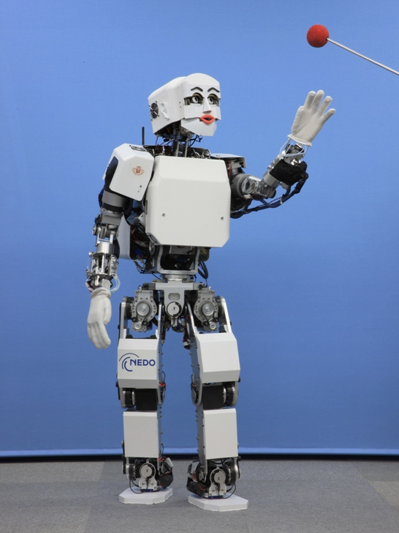
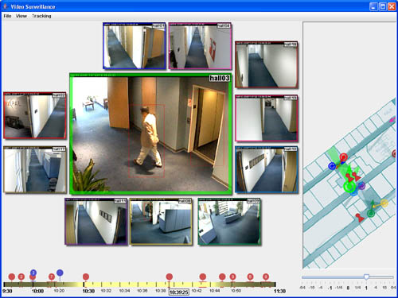
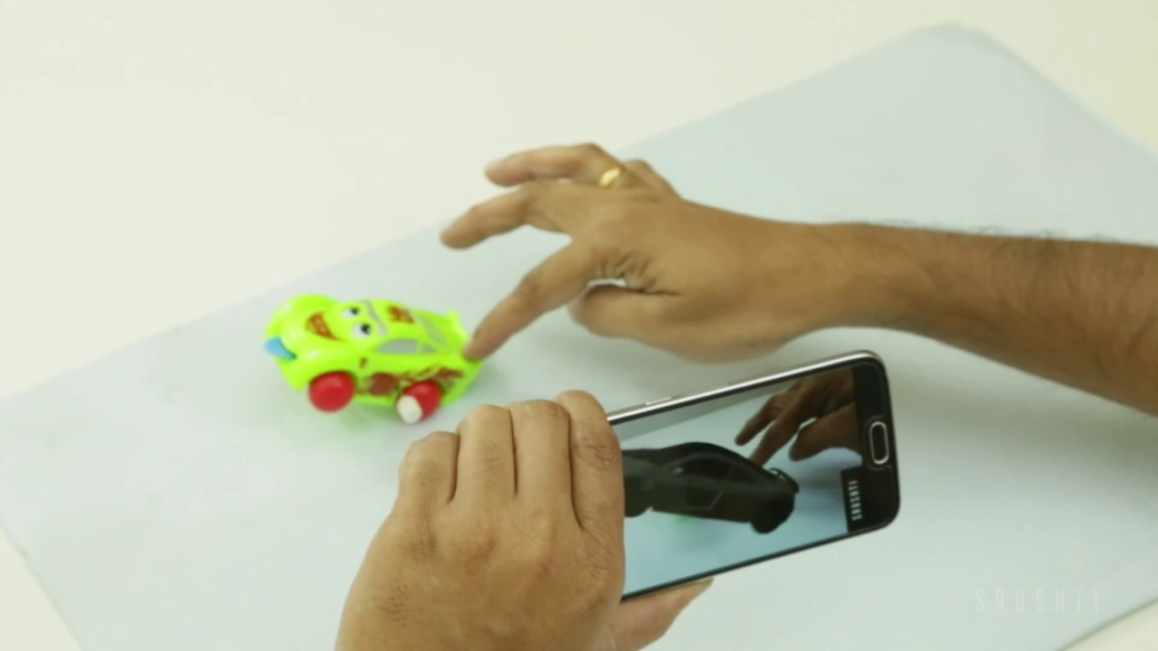
Applications
Robotics
Augmented Reality
Surveillance

Slide 4
Problem
Marked target in first frame
Model this target or discriminate from background
Identify target in future frames

Slide 5
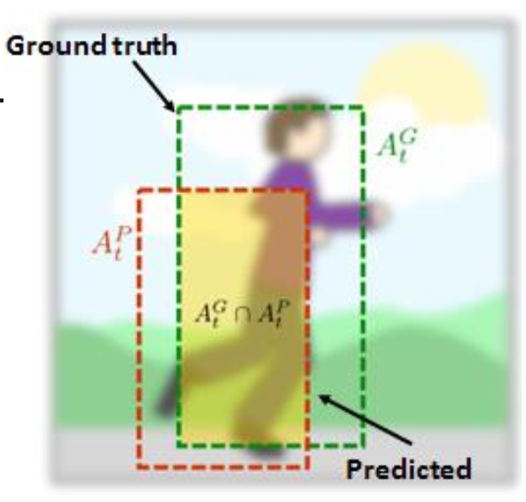
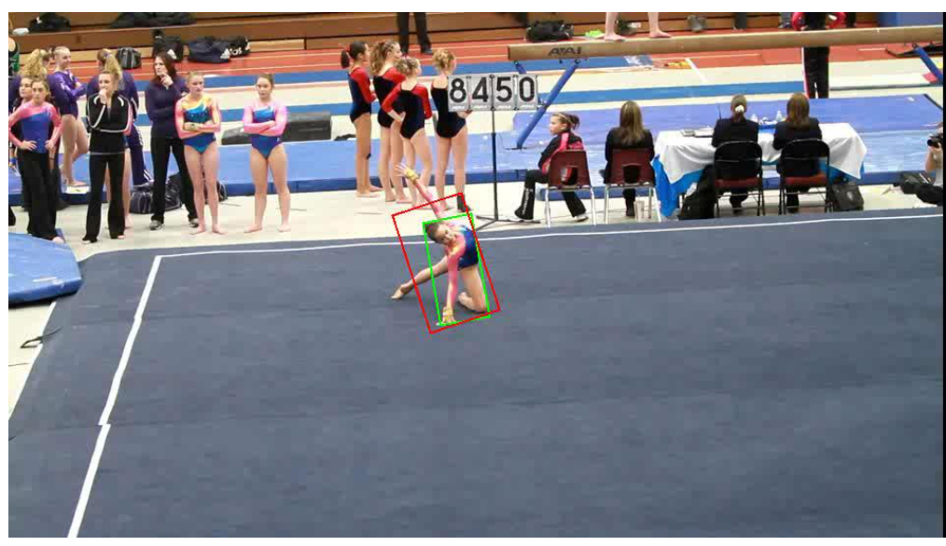
Pictures

Slide 6
Object Tracking Vocab
bounding box
single-object
single-camera
model-free
short-term
overlap

Slide 7
Outline
Problem
Challenges
Dataset
State of the Art
Methods

Slide 8
Between Sequences
Object appearance
Object movement
Background appearance
Background clutter
Background similarity

Slide 9
Within Sequences
Deformation
Motion blur
Camera movement
Illuminations
Transparency
Occlusions
Erratic movement

Slide 10
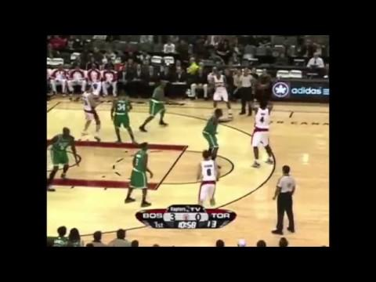
Examples
Bag
Basketball
Car
Soccer
Notes:
Object appearance, Object movement, Background appearance, Background clutter, Background similarity
Deformation, Motion blur, Camera movement, Illuminations, Transparency, Occlusions, Erratic movement

Slide 11
Outline
Problem
Challenges
Dataset
State of the Art
Methods

Slide 12
VOT Challenge
Single-object, single-camera, short-term, model-free trackers evaluated on overlap
Objects visible throughout the whole sequence
4 Datasets/Papers/Methods (2014-2017)
Tutorials, guides, and support forums

Slide 13
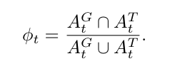
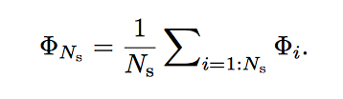
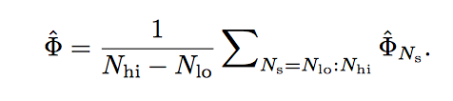
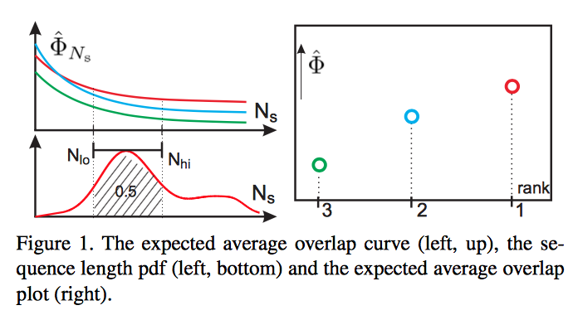
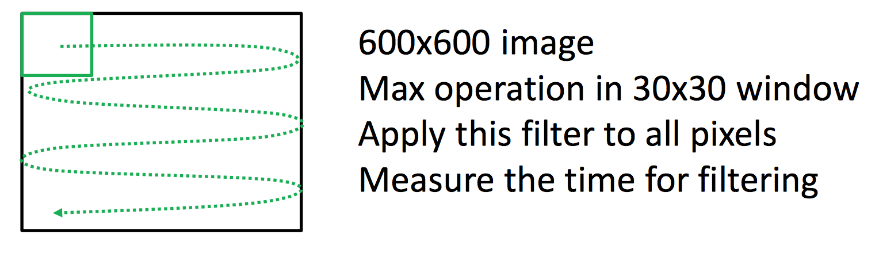
Performance Metrics
Robustness: number of failures
Accuracy
Rank
Expected average overlap
Equivalent filter operations
Notes:
EAO calculates average overlap over long sequences and computes a curve. Then takes a range from point to point along this curve (usually a short portion at the beginning to represent short sequences) and sums all of those into an average.
EFO is tracking time / time required to perform that filter operation
Faster computer means smaller denominator and smaller numerator
Slower computer means bigger denominator and bigger numerator

Slide 14
Outline
Problem
Challenges
Dataset
State of the Art
Methods

Slide 15
State-of-the-Art 2014
CNN: 0
Keypoint Based: 4
Hand Crafted Features: 3D + 12G
Correlation Filter: 8
Part-based: 6
Combination: 5
DSST
SAMF
Notes:
http://www.cs.umd.edu/~djacobs/CMSC426/Convolution.pdf

Slide 16
State-of-the-Art 2015
CNN: 3
Object Proposal Based: 3
Hand Crafted Features: 4D + 9G
Correlation Filter: 16
Part-based: 14
Combination: 5
MDNET 60% accuracy, 0.38 EAO, and 0.69 robustness
DeepSRDCF 56% accuracy, 0.32 EAO, and 1.05 robustness
Notes:
http://www.cs.umd.edu/~djacobs/CMSC426/Convolution.pdf

Slide 17
State-of-the-Art 2016
CNN: 8
Hand crafted features: 5D + 7G
Correlation Filter: 26
Part-based: 18
Combination: 5
TCNN 55% accuracy, 0.32 EAO, and 0.27 robustness
C-COT 54% accuracy, 0.33 EAO, and 0.24 robustness

Slide 18
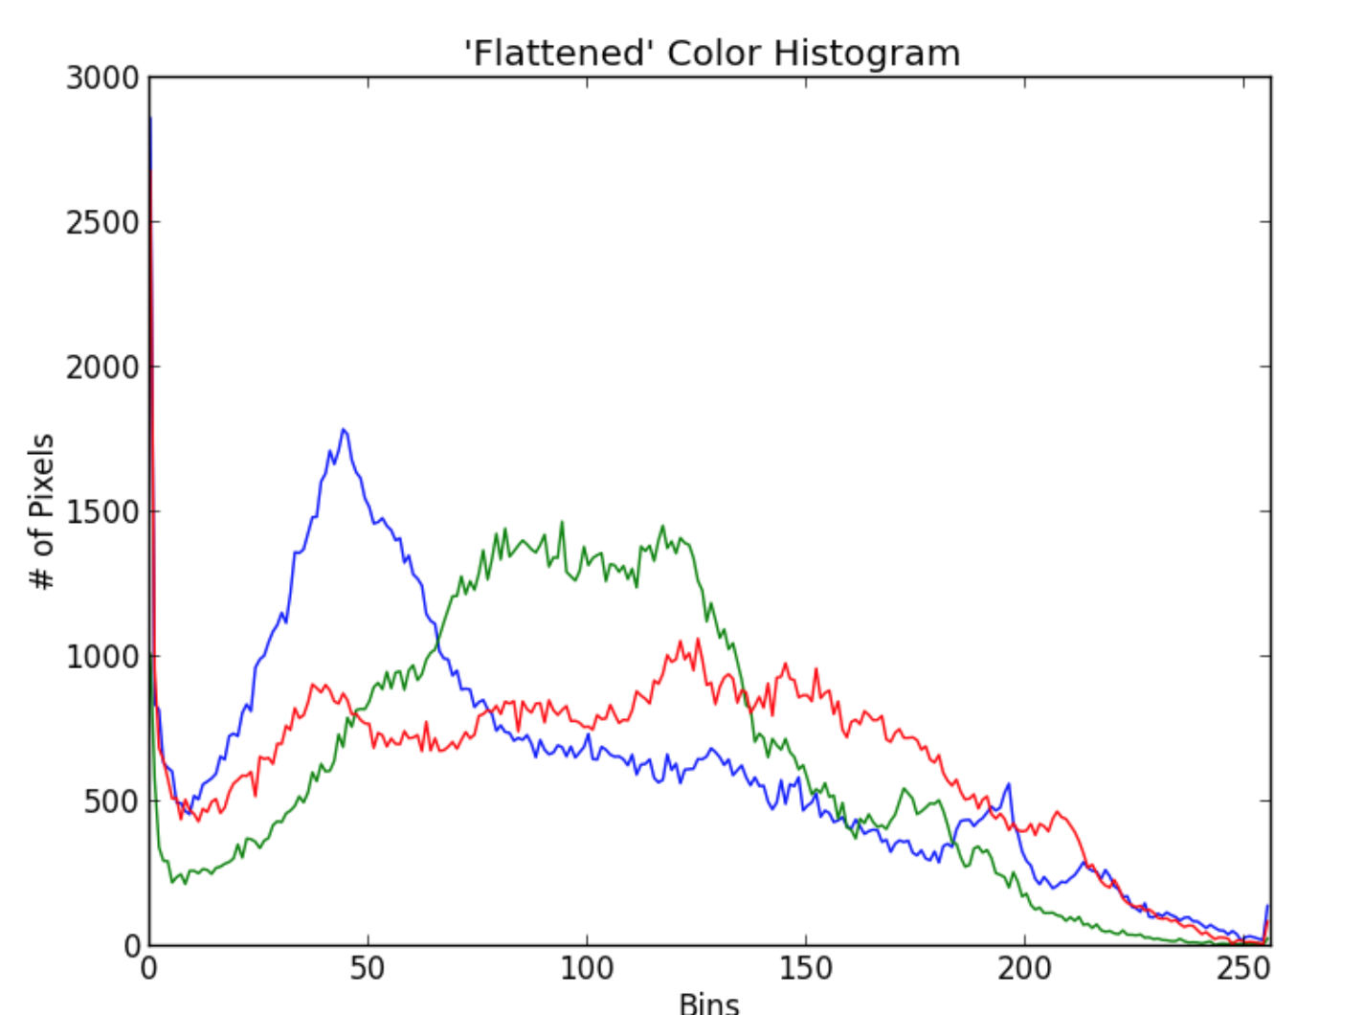
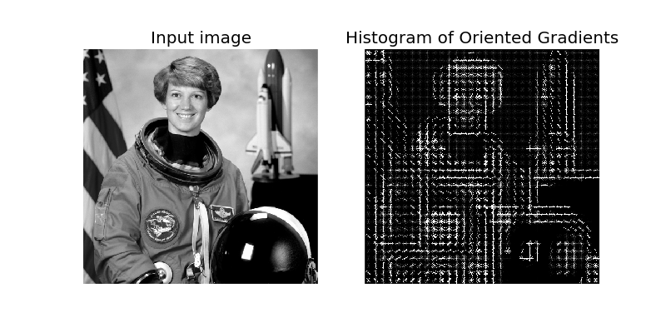
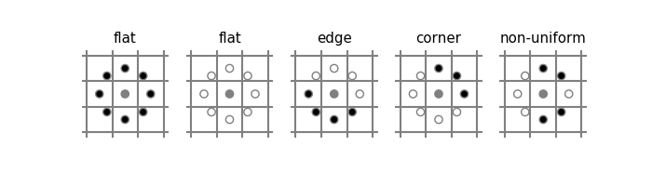
Hand Crafted Features
HSV color histogram
LBP texture
HOG edge
Color name
Notes:
hue saturation value
local binary patterns
histogram of oriented gradients

Slide 19
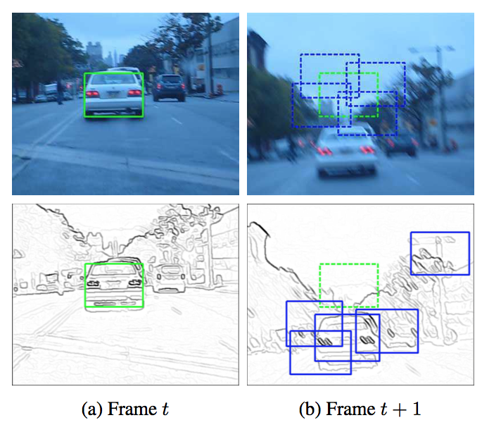
EBT
No implicit motion model
Objectness measure

Slide 20
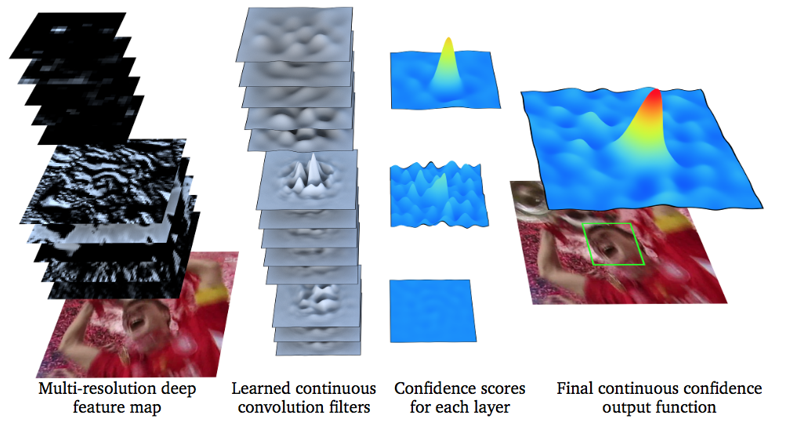
C-COT
Get features from CNN
Shallow layers have higher spatial resolution
Deep layers have lower spatial resolution
Normal Discriminative Correlation Filters can only use one resolution
Notes:
number of pixels used in constructing an image

Slide 21
CNN Methods
Pre-training
Pre-train on ImageNet
VGGNet
Generate a probability map
Fine tune online

Slide 22
MDNet-N
MDNet trained on a complicated set of sequences
MDNet-N uses ImageNet
Hard negative mining

Slide 23
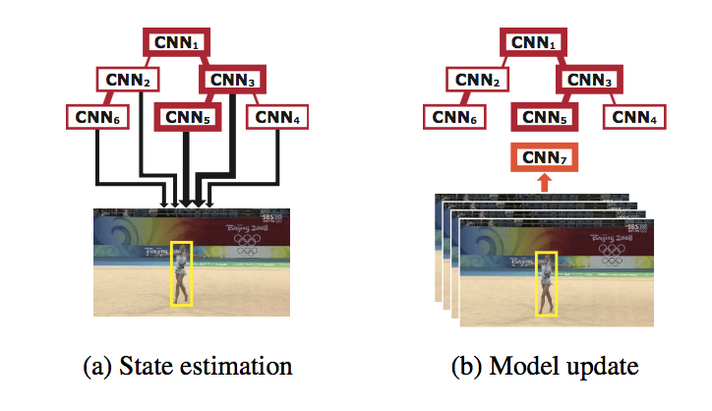
TCNN
Keep track of last 10 in tree
Duplicate VGG base network
Only train last few layers
Branch reliability
Notes:
New model corresponding to the current frame is made by fine tuning the CNN that produced the highest likelihood for state estimation. Each path keeps track of a separate history about target appearance changes. Robust to short-term occlusions and tracking failures.

Slide 24
Outline
Problem
Challenges
Dataset
State of the Art
Methods

Slide 25
CNN Applications
Use MDNet-N basics
Improve candidate search
Replace core network
Improve feature selection

Slide 26
Conferences
ICIP
ECCV
The International Conference on Image Processing
IEEE Conference
February 7, 2018
B Rank (94)
The European Conference on Computer Vision
Springer Science
March 14, 2018
A Rank (3)

Slide 27
Visual Object Tracking
Elliot Greenlee, J.T. Liso
Questions?

